Slide 1
Process Concept
A process is a program in execution.
A process is more than the program code, which is sometimes known as the text section. It also includes the current activity, as represented by the value of the program counter and the contents of the processor’s registers.
A process generally also includes the process stack, which contains temporary data (such as function parameters, return addresses, and local variables), and a data section, which contains global variables. A process may also include a heap, which is memory
that is dynamically allocated during process run time.

Slide 2
Process Concept
A program by itself is not a process. A program is a passive entity, such as a file containing a list of instructions stored on disk (often called an executable file). In contrast, a process is an active entity, with a program counter specifying the next instruction to execute and a set of associated resources. A program becomes a process when an executable file is loaded into memory.

Slide 3
Process State
As a process executes, it changes state. The state of a process is defined in part by the current activity of that process. A process may be in one of the following states:
New. The process is being created.
Running. Instructions are being executed.
Waiting. The process is waiting for some event to occur (such as an I/O completion or reception of a signal).
Ready. The process is waiting to be assigned to a processor.
Terminated. The process has finished execution.

Slide 4
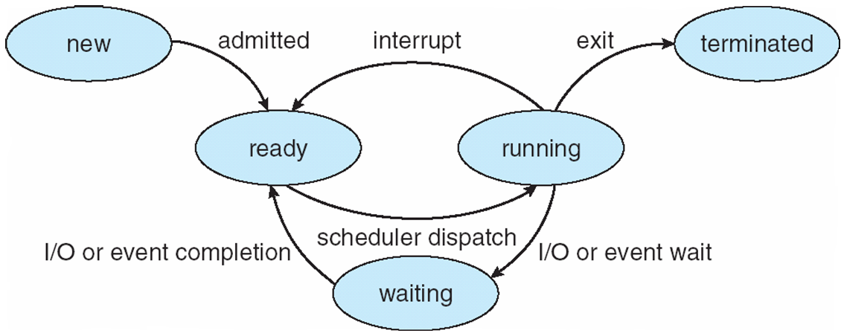
Process State

Slide 5
Process Control Block (PCB)
Each process is represented in the operating system by a process control block (PCB)—also called a task control block. It contains many pieces of information associated with a specific process, including these:
Process state – running, waiting, etc
Program counter – location of instruction to next execute
CPU registers – contents of all process-centric registers
CPU scheduling information- priorities, scheduling queue pointers
Memory-management information – memory allocated to the process
Accounting information – CPU used, clock time elapsed since start, time limits
I/O status information – I/O devices allocated to process, list of open files

Slide 6
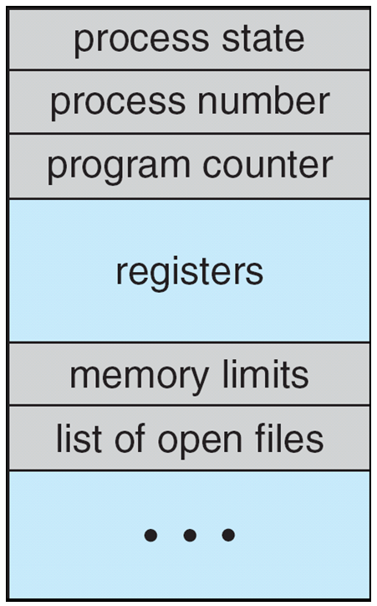
Process Control Block (PCB)

Slide 7
Process Scheduling
The objective of multiprogramming is to have some process running at all times, to maximize CPU utilization. The objective of time sharing is to switch the CPU among processes so frequently that users can interact with each program
To meet these objectives, the process scheduler selects an available process (possibly from a set of several available processes) for program execution on the CPU. For a single-processor system, there will never be more than one running process. If there are more processes, the rest will have to wait until the CPU is free and can be rescheduled.

Slide 8
Process Scheduling Queues
As processes enter the system, they are put into a job queue, which consists of all processes in the system.
The processes that are residing in main memory and are ready and waiting to execute are kept on a list called the ready queue. A ready-queue header contains pointers to the first and final PCBs in the list. Each PCB includes a pointer field that points to the next PCB in the ready queue.
The system also includes other queue: The list of processes waiting for a particular I/O device is called a device queue.

Slide 9
Process Scheduler
A process migrates among the various scheduling queues throughout its lifetime. The operating system must select, for scheduling purposes, processes from these queues in some fashion. The selection process is carried out by the appropriate scheduler.
The long-term scheduler, or job scheduler, selects processes from this pool and loads them into memory for execution.
The short-term scheduler, or CPU scheduler, selects from among the processes that are ready to execute and allocates the CPU to one of them.
The primary distinction between these two schedulers lies in frequency of execution. The short-term scheduler must select a new process for the CPU frequently; The long-term scheduler executes much less frequently.

Slide 10
Context Switch
Switching the CPU to another process requires performing a state save of the current process and a state restore of a different process. This task is known as a context switch.
When an interrupt occurs, the system needs to save the current context of the process running on the CPU so that it can restore that context when its processing is done, essentially suspending the process and then resuming it. The context is represented in the PCB of the process.
When a context switch occurs, the kernel saves the context of the old process in its PCB and loads the saved context of the new process scheduled to run. Context-switch time is pure overhead, because the system does no useful work while switching.

Slide 11
Context Switch
Switching speed varies from machine to machine, depending on the memory speed, the number of registers that must be copied, and the existence of special instructions (such as a single instruction to load or store all registers). A typical speed is a few milliseconds

Slide 12
Process Creation
The processes in most systems can execute concurrently, and they may be created and deleted dynamically. Thus, these systems must provide a mechanism for process creation and termination.
During the course of execution, a process may create several new processes. As mentioned earlier, the creating process is called a parent process, and the new processes are called the children of that process. Each of these new processes may in turn create other processes, forming a tree of processes.

Slide 13
Process Creation
In general, when a process creates a child process, that child process will need certain resources (CPU time, memory, files, I/O devices) to accomplish its task.
A child process may be able to obtain its resources directly from the operating system, or it may be constrained to a subset of the resources of the parent process.
The parent may have to partition its resources among its children, or it may be able to share some resources (such as memory or files) among several of its children. Restricting a child process to a subset of the parent’s resources prevents any process from overloading the system by creating too many child processes.

Slide 14
Process Creation
When a process creates a new process, two possibilities for execution exist:
1. The parent continues to execute concurrently with its children.
2. The parent waits until some or all of its children have terminated.
There are also two address-space possibilities for the new process:
1. The child process is a duplicate of the parent process (it has the same program and data as the parent).
2. The child process has a new program loaded into it.

Slide 15
Process Termination
A process terminates when it finishes executing its final statement and asks the operating system to delete it. All the resources of the process—including physical and virtual memory, open files, and I/O buffers—are deallocated by the operating system.
A parent may terminate the execution of one of its children for a variety of reasons, such as these:
The child has exceeded its usage of some of the resources that it has been allocated. (To determine whether this has occurred, the parent must have a mechanism to inspect the state of its children.)
The task assigned to the child is no longer required.
The parent is exiting, and the operating system does not allow a child tocontinue if its parent terminates

Slide 16
Inter-process Communication (IPC)
Processes executing concurrently in the operating system may be either independent processes or cooperating processes.
A process is independent if it cannot affect or be affected by the other processes executing in the system. Any process that does not share data with any other process is independent.
A process is cooperating if it can affect or be affected by the other processes executing in the system.
Cooperating processes require an inter-process communication (IPC) mechanism that will allow them to exchange data and information. There are two fundamental models of inter-process communication: shared memory and message passing.

Slide 17
Inter-process Communication (IPC)
Shared memory
Inter-process communication using shared memory requires communicating processes to establish a region of shared memory. Typically, a shared-memory region resides in the address space of the process creating the shared-memory segment. Other processes that wish to communicate using this shared-memory segment must attach it to their address space.
Normally, the operating system tries to prevent one process from accessing another process’s memory. Shared memory requires that two or more processes agree to remove this restriction. They can then exchange information by reading and writing data in the shared areas. The processes are also responsible for ensuring that they are not writing to the same location simultaneously.

Slide 18
Inter-process Communication (IPC)
Message passing
Cooperating processes to communicate with each other via message-passing
Message passing provides a mechanism to allow processes to communicate and to synchronize their actions without sharing the same address space.
It is particularly useful in a distributed environment, where the communicating processes may reside on different computers connected by a network. For example, an Internet chat program could be designed so that chat participants communicate with one another by exchanging messages.

